Slide 1

Artificial Neural Network

Slide 2
What is Artificial Neural Network?
An Artificial neuron is a mathematical function conceived as a crude model, or abstraction of biological neurons.
Artificial neurons are the constitutive units in an artificial neural network
The artificial neuron receives one or more inputs (representing the one or more dendrites) and sums them to produce an output (synapse).
An ANN is an efficient information processing system, which is highly parallel in nature and heavily interconnected so processing is distributed among neurons.

Slide 3
Usefulness & Capabilities of Artificial Neural Network
Nonlinearity
ANN exploits Linear and non linear system. If there is a system when we give some set of input and except output then system is linear if relation between input and output is described by linear equation. System is non-linear if we can write output in high order term. Most of the real time problems are nonlinear in nature. So nonlinear neural network model is interconnection of nonlinear neurons. Non-linearity is highly distributed in nature.
2.Input/output mapping
ANN can learn with the help of a teacher. In its learning mechanism teacher train the network so that desired output is obtained from network for this network adjust its parameter to achieve the target.

Slide 4
Usefulness & Capabilities of Artificial Neural Network (contd.)
3.Adaptivity
We can adapt ourselves to the changes in the surrounding environment and we made some internal adjustment.
4.Evidential Response
Decision with a measure of confidence
5. Fault Tolerance
Biological neural network is highly fault tolerant as some of its neurons are malfunctioning then also brain activities can be performed. We want to incorporate this fault tolerance into ANN, if faults are high then degree of degradation is also high so degradation occurs gracefully that we call “graceful degradation”

Slide 5
Usefulness & Capabilities of Artificial Neural Network (contd.)
6. VLSI Implementability
High degree of parallelism makes it potentially fast for the computation of certain tasks. Due to this reason it is well suited for VLSI technology like associative memory
7. Neurobiological analogy
Motivated by analogy of brain

Slide 6
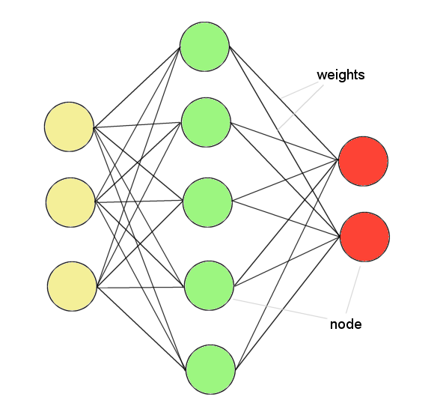
ANNs – The basics
ANNs incorporate the fundamental components of biological neural nets:
Neurones (nodes)
Synapses (weights)
Soma (Net Input)
Axon (Output)

Slide 7
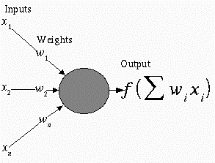
Mathematical Model of Artificial Neuron

Slide 8
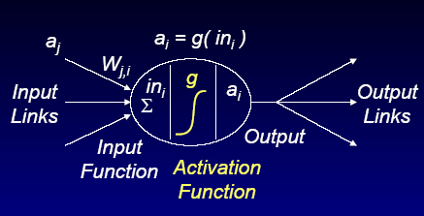
More detail figure

Slide 9
Neural Network Terminology
Weight: the amount of information about the input that is required to solve a problem is stored in the form of weights.
Each signal is multiplied with an associated weight w1, w2, w3,…
j
Activation: Input given to i is activation of j (a_{j}) when i gives input to other neuron then a_{i} is activation of i neuron
Wj,i
i

Slide 10
Bias
A bias term can be treated as a connection weight from a special unit with a constant, nonzero activation value.
It has impact in calculating the net input.
It is a type of activation function like a_{i} become 1 if the total sum is 0.7 and 0 if sum is 0.4
Two types of bias
  +ve it helps in increasing the net input of the network
  -ve it helps in decreasing the net input of the network
  Thus as a bias effect , the output of the network can be varied

Slide 11
Threshold
The Threshold value is used in the activation function
A comparison is made between the calculated net input and the threshold to obtain the network output
For each and every application, there is a threshold limit
Ex a DC motor has its threshold at 1500 rpm then if the runs higher than this speed it may damage motor coils
Similarly NN also contain it as
f (net) = 1 if net >= θ
-1 if net < θ
Here θ is threshold function

Slide 12
Classification of Neural Network
ANN can be classified on the basis of
1 Architecture of the network
2 Activation function applied to the neurons
3 Learning methods

